Slide 1

Frshop Online Veggie Store
Presented By

Slide 2
Introduction
As we know that searching of fresh vegetables in market takes quite a long time and some times we even need to suffice with what is available near by . So , With the help of this web application customers can search and order wide range of fresh vegetable/fruits/groceries just with a click.

Slide 3
Technology Used
We used Java Spring-Boot as backend and React JS as Frontend in our Project.
Spring-Boot :–
The main goal of the Spring Boot framework is to reduce overall development time and increase efficiency. React has become the first choice for frontend because it gives developers the ability to work with a virtual browser (more friendly than the real browser). Also, a JavaScript developer can become a productive developer in a few hours because there is a small API to learn, a few functions, and how to use them…
React :–
React allows developers to create large web applications that can change data, without reloading the page. The main purpose of React is to be fast, scalable, and simple. Spring

Slide 4



User Classes
Customer
Admin
Seller
In this module Admin can manage Customers and Sellers. Will maintain one to one relation.
In this module Seller can register , login and can upload their product details.
In this module a customer will register, update details or search from various categories available.

Slide 5
OBJECTIVE
01
The Freshop is a website that is to be developed to provide the Easy access to Customers and suppliers , online buying and selling fresh vegetables.
02
This system provides service to the Customers and Suppliers.
This WebApp will allow Suppliers to establish one to one relationships with candidates.
03
04
This app will primarily focus on Management of Fresh Veggies.
05
By this Customer can easily search for Fresh vegetables and maintain their cart.

Slide 6
Customer Module
After successful registration ,the Customer can
Search for Fresh vegetables available.
Can edit his/her profile ,
Delete account and
Can maintain a cart for reference.

Slide 7
Seller Module
After successful registration and authentication from Admin , the Seller can
Upload new products. Apart from this,
seller can edit his/her profile ,
Can Delete their account
can change price of products

Slide 8
Admin Module
The Admin can
Approve or disapprove the Sellers.
He /she can see User details ,
Manage account and delete Customer account.

Slide 9
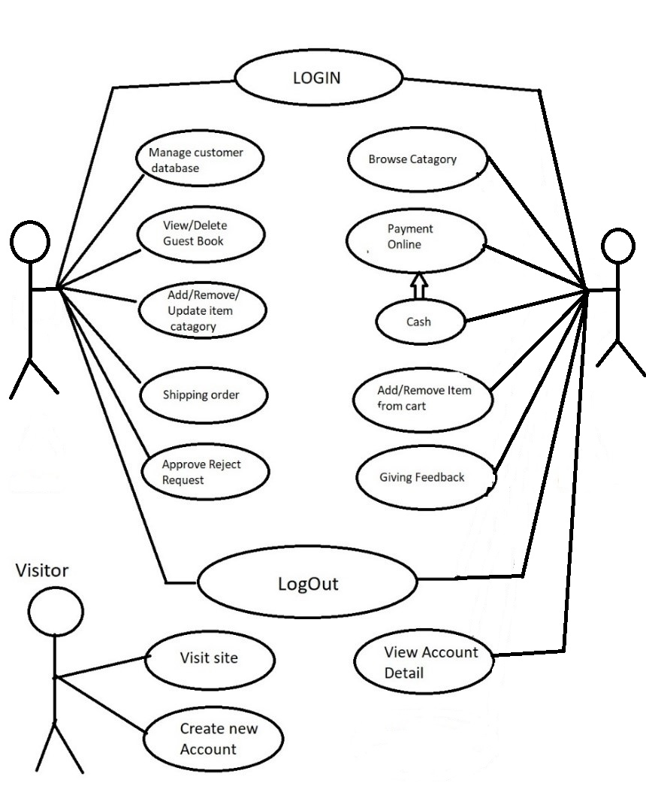
Use Case

Slide 10
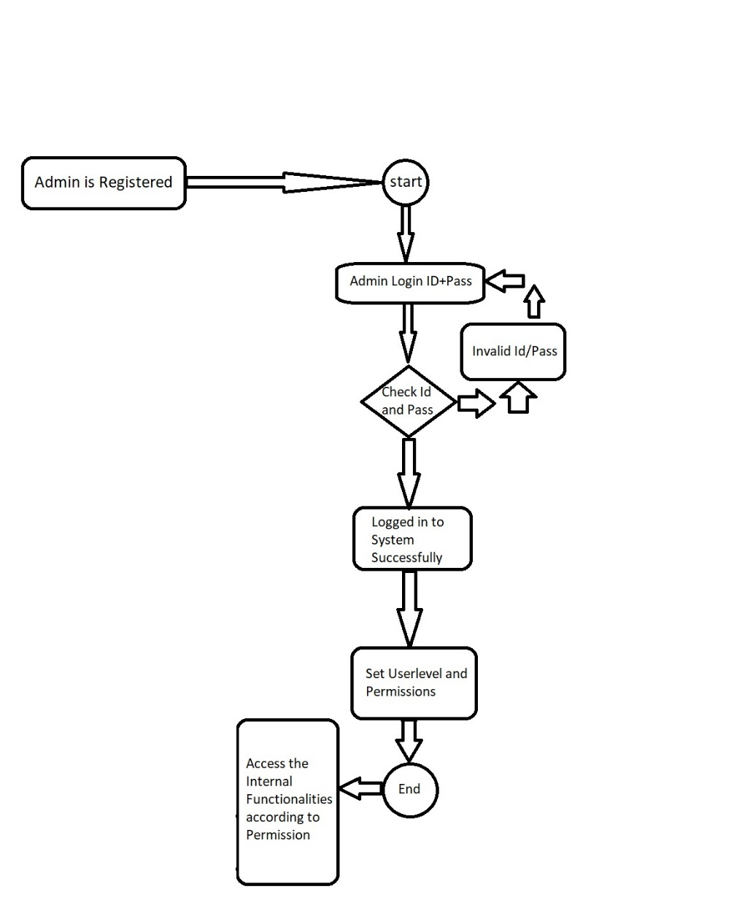
Activity Diagram : Admin

Slide 11
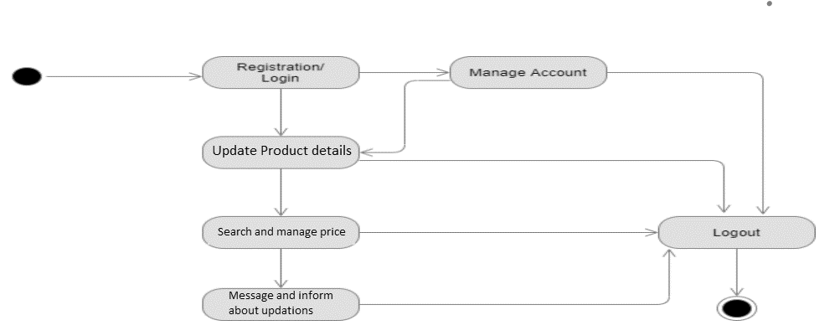
Activity Diagram : Seller

Slide 12
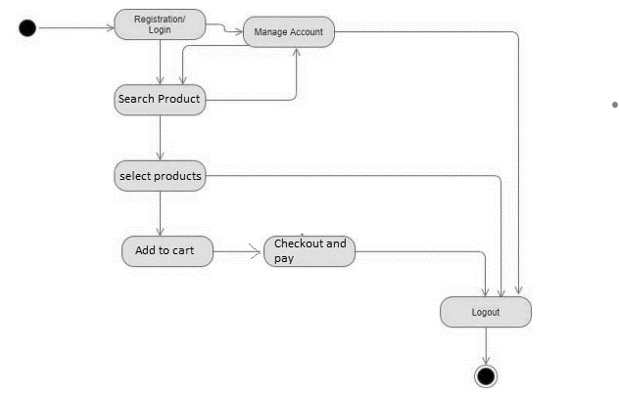
Activity Diagram : Customer

Slide 13
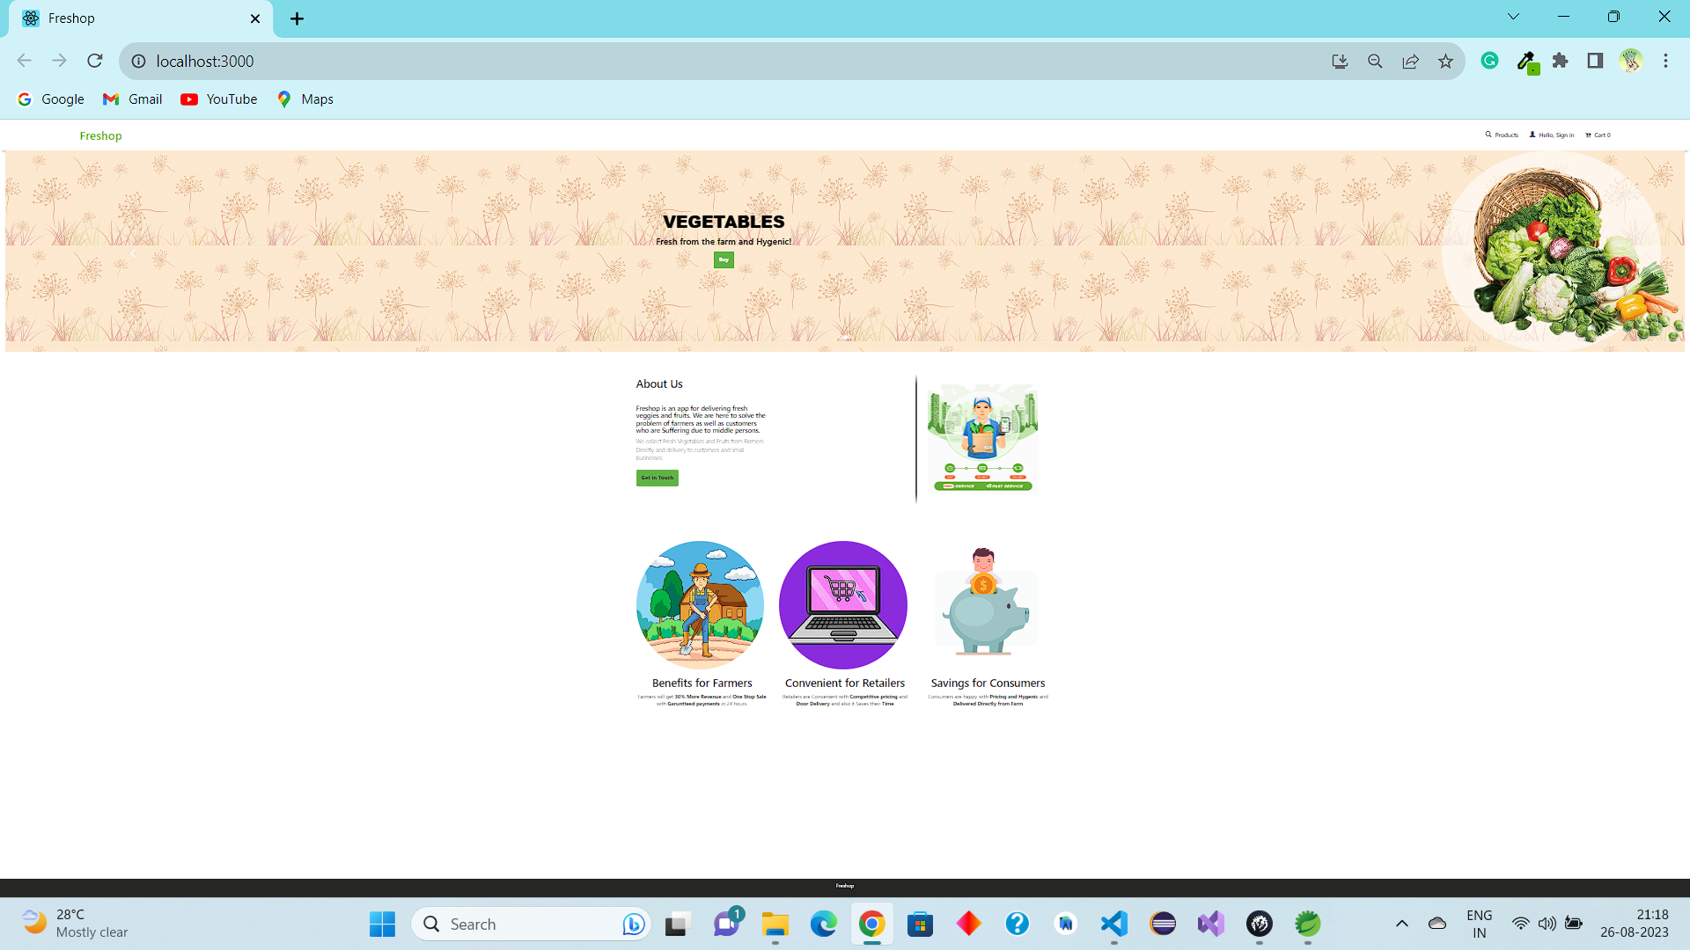

Slide 14
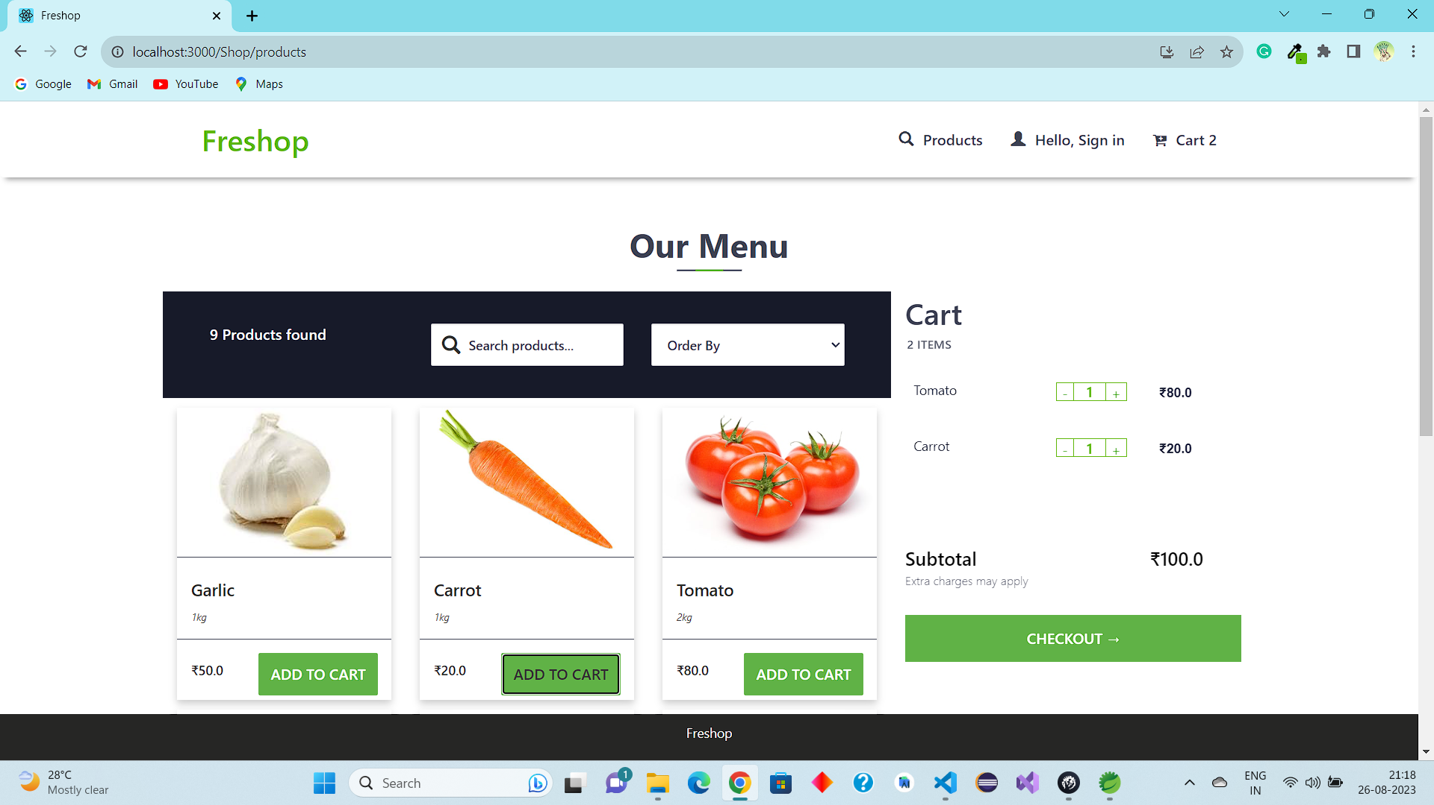

Slide 15
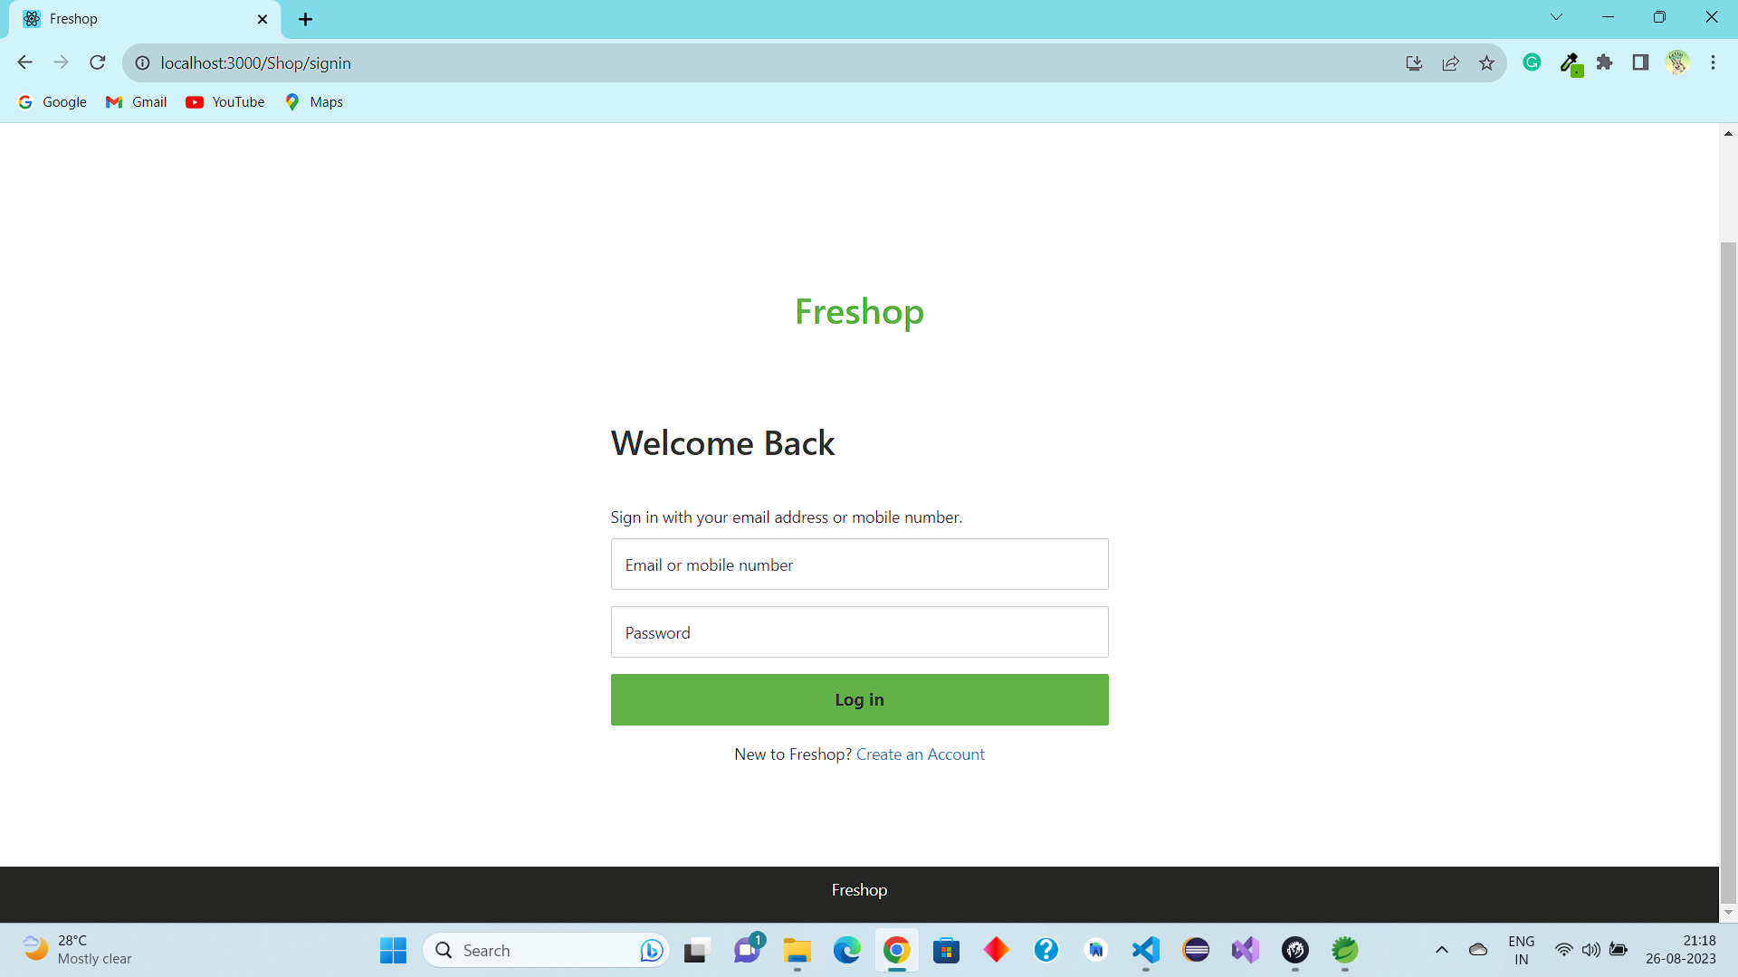

Slide 16
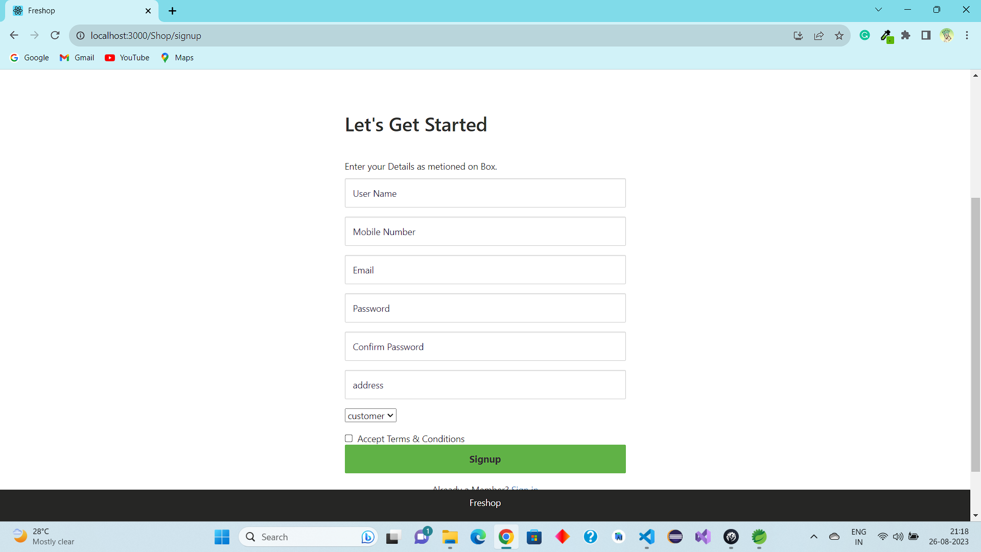

Slide 17
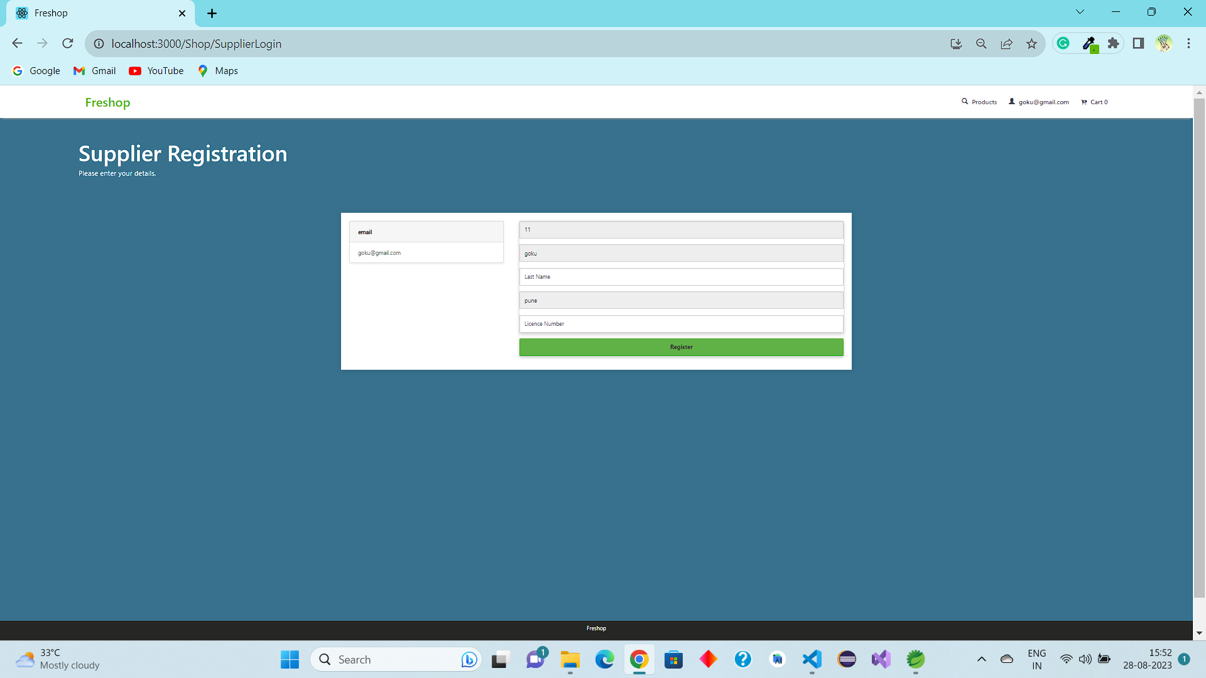

Slide 18
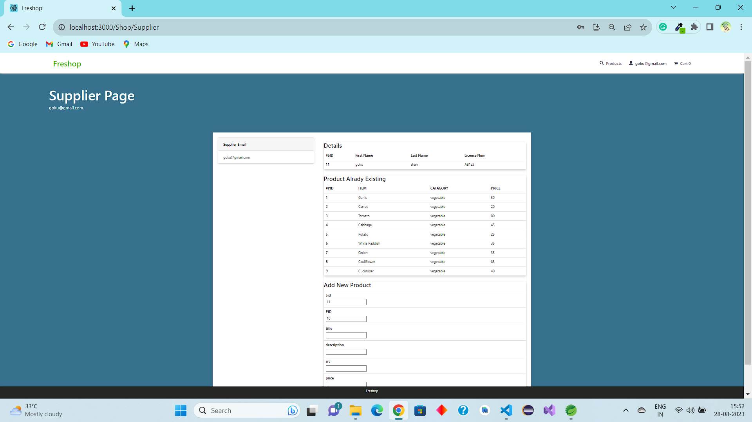

Slide 19
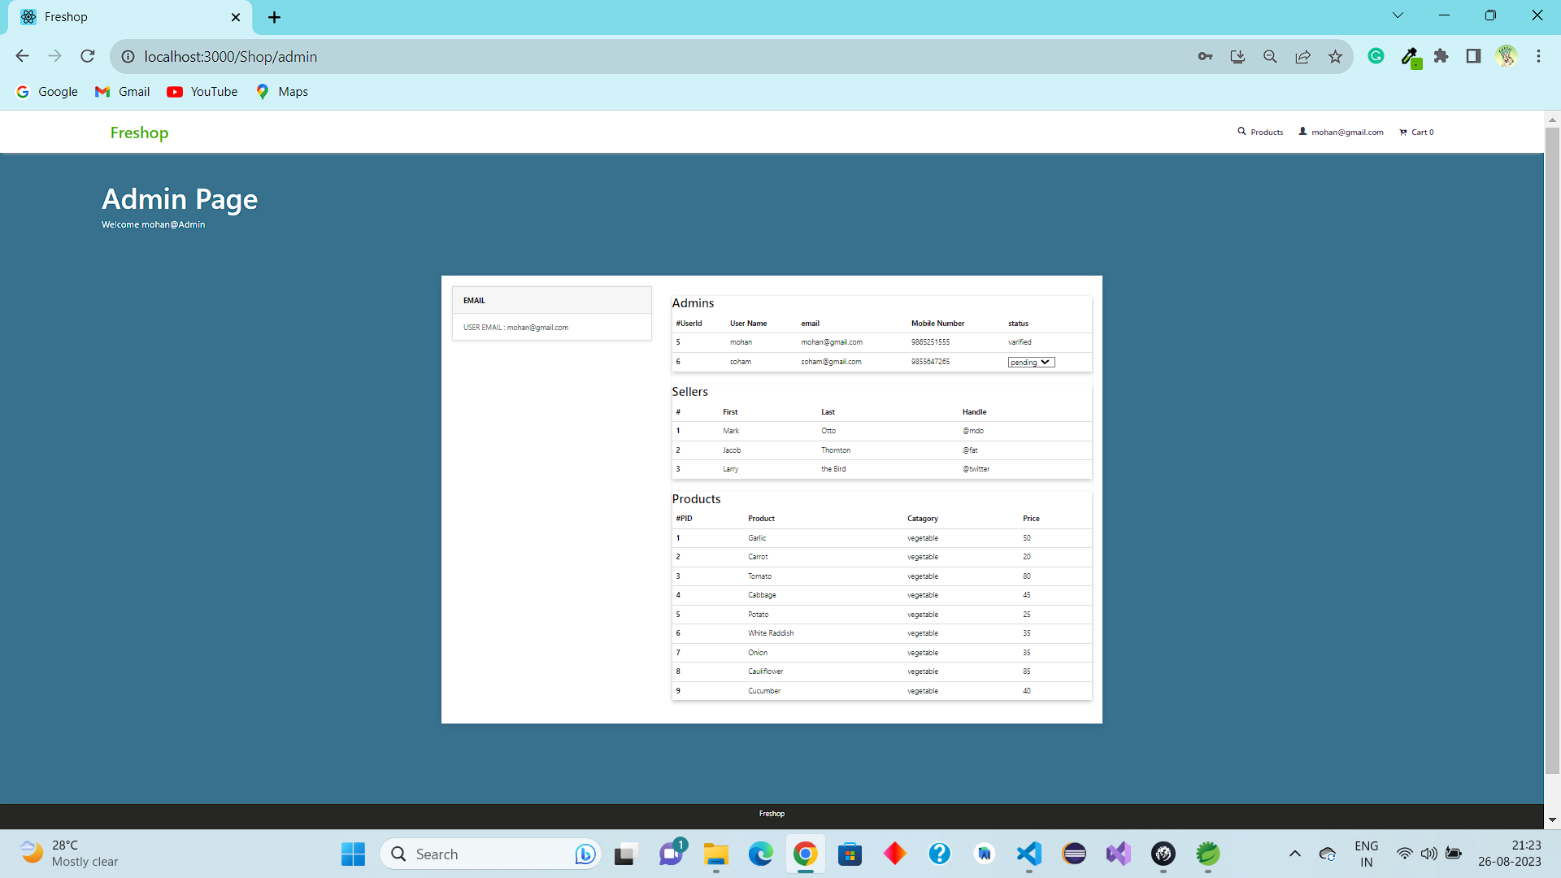

Slide 20
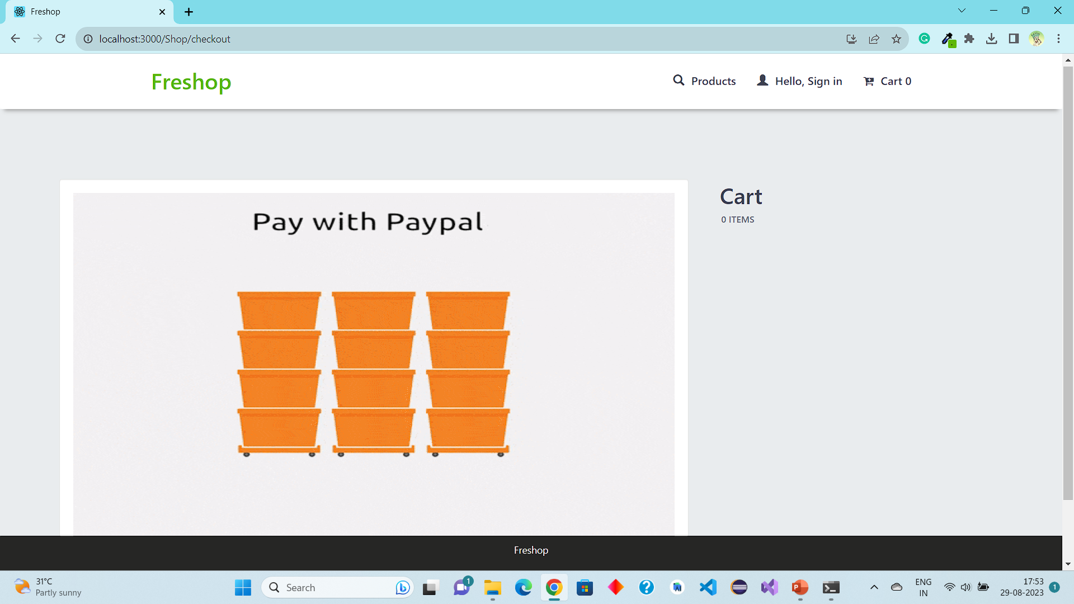

Slide 21
Thank You

